Slide 1
Container Security Best Practices
ANUBOLU BHARATH SECURE WORKLOAD TAC

Slide 2
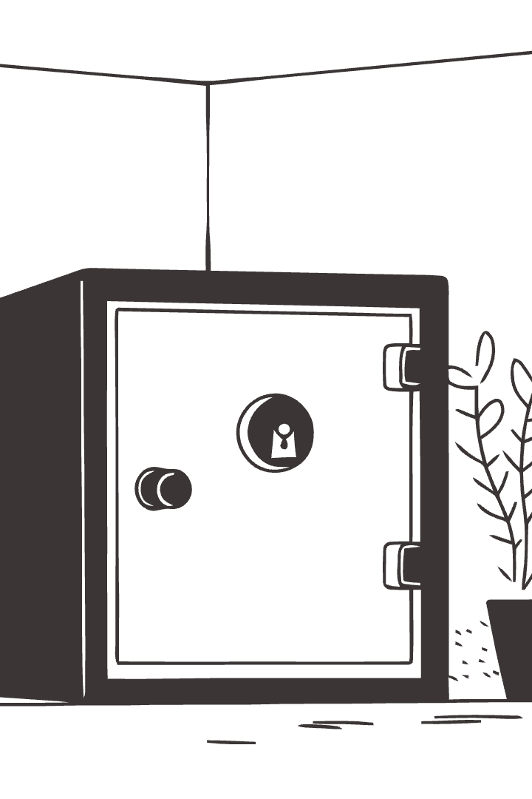
Container Security Best Practices: A Comprehensive Guide
Containers have revolutionized the way we build and deploy applications, offering flexibility and speed. But as the complexity of containerized environments grows, so do security threats. This presentation will provide practical guidelines for securing your containerized applications from image creation to runtime.
by Bharath Anubolu

Slide 3
Why Container Security Matters
Containers have become the dominant deployment model for modern applications. Their ability to package and isolate software components has transformed the way we develop and deploy applications, enabling faster delivery, improved scalability, and efficient resource utilization.
However, this increased adoption has brought new security challenges. The unique nature of containerized environments requires specialized security approaches. Vulnerabilities in container images or runtime environments can have significant consequences, potentially compromising entire infrastructure and exposing sensitive data.

Slide 4
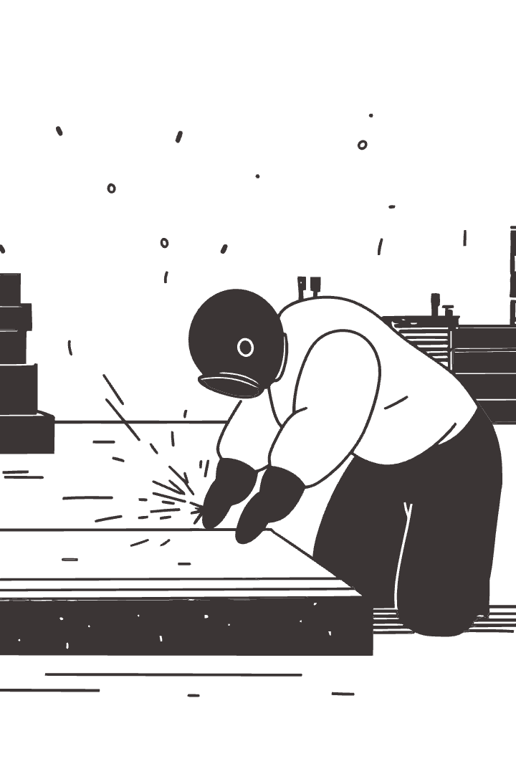
Image Security Fundamentals
Use Minimal Base Images
Automated Image Scanning
Base images are the foundation upon which container images are built. Choose minimal base images, such as alpine or distroless, to reduce the attack surface by eliminating unnecessary components. For example, use `FROM alpine:latest` or `FROM gcr.io/distroless/base`.
Implement automated vulnerability scanning during the image build process. Tools like Trivy, Clair, Anchore, and Snyk can identify known vulnerabilities in your images, helping you proactively address them. Example: `trivy image your-image:latest`.
Multi-Stage Builds
Multi-stage builds create smaller, more secure images by separating the build environment from the runtime environment. The final image only includes the necessary artifacts, minimizing dependencies and reducing the attack surface.

Slide 5
Layer Caching and Security Order Dockerfile instructions carefully
Place less frequently changing layers first
Use multi-stage builds to reduce final image size and potential vulnerabilities
Use Minimal Base Images Start with official, minimal images like Alpine Linux
Reduce potential vulnerabilities by using the smallest possible image
Example: dockerfile
# Less secure FROM ubuntu:latest # More secure FROM alpine:latest
# Multi-stage build
FROM maven:3.8.1-openjdk-11 AS build
COPY src /home/app/src
COPY pom.xml /home/app
RUN mvn -f /home/app/pom.xml clean package
FROM openjdk:11-jre-slim
COPY --from=build /home/app/target/app.jar /usr/local/lib/app.jar
Use Official Images
Prefer official Docker Hub images
Regularly updated and maintained
Vetted for security vulnerabilities
Regularly update base images
Remove unnecessary packages and dependencies
Use --no-install-recommends when installing packages
Avoid Running as Root Create and use a non-root user in your Dockerfile
Implement the principle of least privilege
Example: dockerfile
RUN adduser -D appuser USER appuser
RUN apt-get update && \
apt-get install -y --no-install-recommends \
package-name && \
rm -rf /var/lib/apt/lists/*

Slide 6

Runtime Container Security
Least Privilege Principle
Resource Constraints
Run containers as non-root users to limit potential damage. Use read-only file systems where possible to further reduce the attack surface. Example: `RUN adduser --disabled-password --gecos '' appuser USER appuser`.
Limit the resources available to containers to prevent resource exhaustion attacks. Use resource limits and requests in your Kubernetes deployments. Example: `resources: limits: cpu: 500m memory: 512Mi requests: cpu: 250m memory: 256Mi`.
Security Context
Leverage security contexts in Kubernetes to define privilege and access control settings for pods and containers. This ensures that applications run with appropriate levels of privilege and isolation, enhancing the security of your Kubernetes environment.

Slide 7
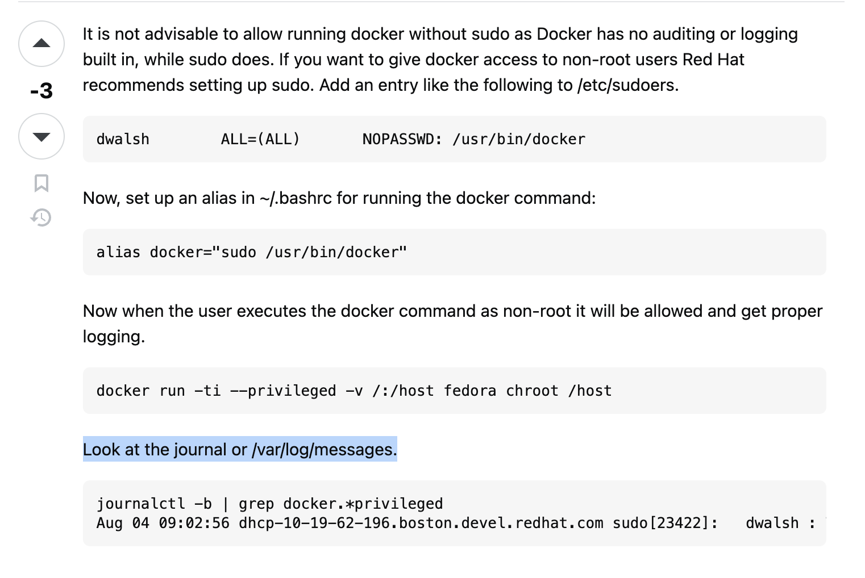

Slide 8
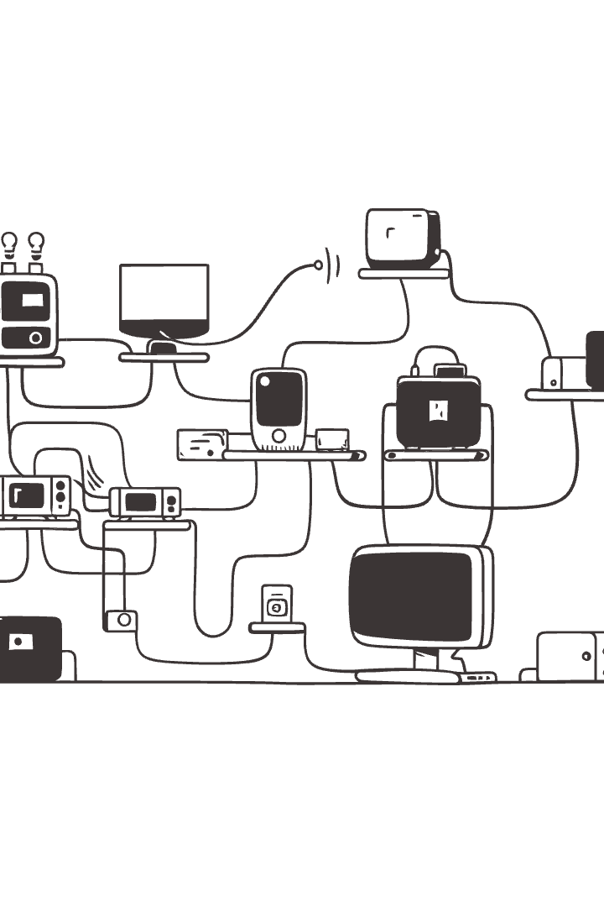


Network Security
Network Segmentation
Network Firewalls
Implement network segmentation using container network policies to isolate containers and restrict communication between them. This helps limit the impact of attacks and prevents lateral movement within your network.
Use network firewalls at the container level to filter incoming and outgoing traffic. Configure rules to allow only necessary traffic, blocking malicious connections and reducing the attack surface.

Slide 9

Access Control and Permissions
1
Use role-based access control (RBAC) in Kubernetes to manage access to sensitive resources. Assign roles and permissions based on user or group, allowing only authorized access to specific resources.
2
Implement least privilege access control principles. Ensure that users and services only have the permissions necessary to perform their tasks, reducing the potential for unintended actions.
3
Use secrets to store sensitive information like passwords and API keys securely. Avoid hardcoding sensitive information directly into containers, as this can increase vulnerability to attacks.

Slide 10



Compliance and Monitoring
1
Security Audits
2
Vulnerability Scanning
3
Log Monitoring
Ensure compliance with relevant industry standards and regulations. Conduct regular security audits to identify and address vulnerabilities. Implement continuous monitoring of container logs and system activity to detect suspicious behavior or security incidents.

Slide 11

Key Takeaways and Next Steps
By prioritizing image security, runtime security, access control, and compliance, you can build a strong security posture for your containerized applications. Remember to implement these best practices consistently and adapt your approach as new threats emerge. Continuous improvement and a proactive security mindset are crucial for protecting your containerized applications in the ever-evolving threat landscape.

